Slide 1
CPSC 411 Final Project
Jonathan Lam

Slide 2
My Application
Stay on Track! by Jonathan Lam
I have spent around 1-2 hours everyday for the past few weeks, but it might take another 2-4 weeks to finish implementing all features

Slide 3

The Elevator Pitch
If you're like me and struggle with not eating enough or (in my case) eating to much, looking for a great app to track your daily nutrition is essential. My app "Stay on Track!" will help anyone effortlessly keep track of nutrition management and reach their goals. While there are a numerous amount of fitness apps out there, this is the only app you will ever need again!

Slide 4
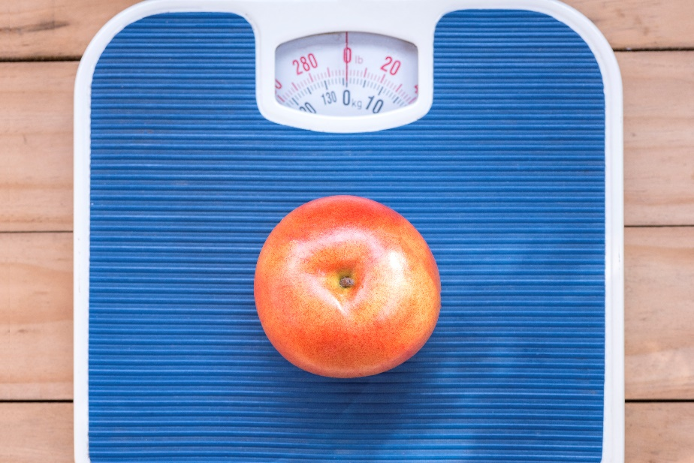
Users
Users are people who want to become healthier by keeping track of their nutritional intake and reach their health goals

Slide 5
Features
Users can track daily nutrition
Users save nutrition information of food for later
Users can look at previous data entries
Users can set nutrition goals
Users can see if they reached their goals

Slide 6
Current Progress
Feature | Finish
Users can track daily nutrition | In Progress
Users save nutrition information of food for later | Done
Users can look at previous data entries | Done
Users can set nutrition goals | In Progress
Users can see if they reached their goals | In Progress

